Slide 1








Notes:
Q: What do you want to do with your life? What do you want to be? How can you do that?
The Mississippi Economic Council has put these programs in place to help build a foundation for your success — getting you one step closer to achieving your goals.

Slide 2

















Notes:
These are several sponsors who are investing in your success, because they believe in your potential. And one day, maybe, you can even work for them.

Slide 3

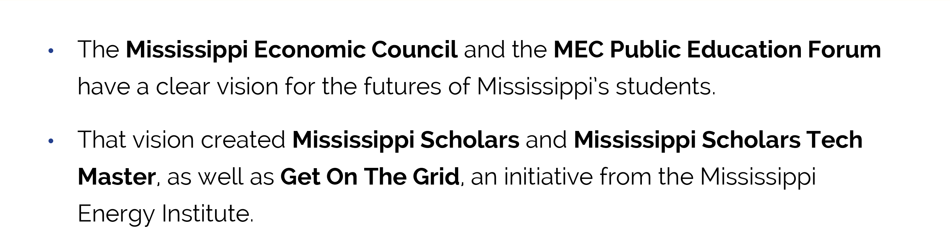



Slide 4

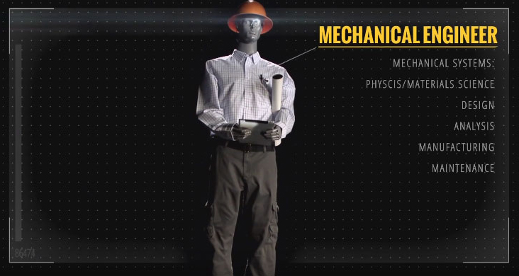

Slide 5
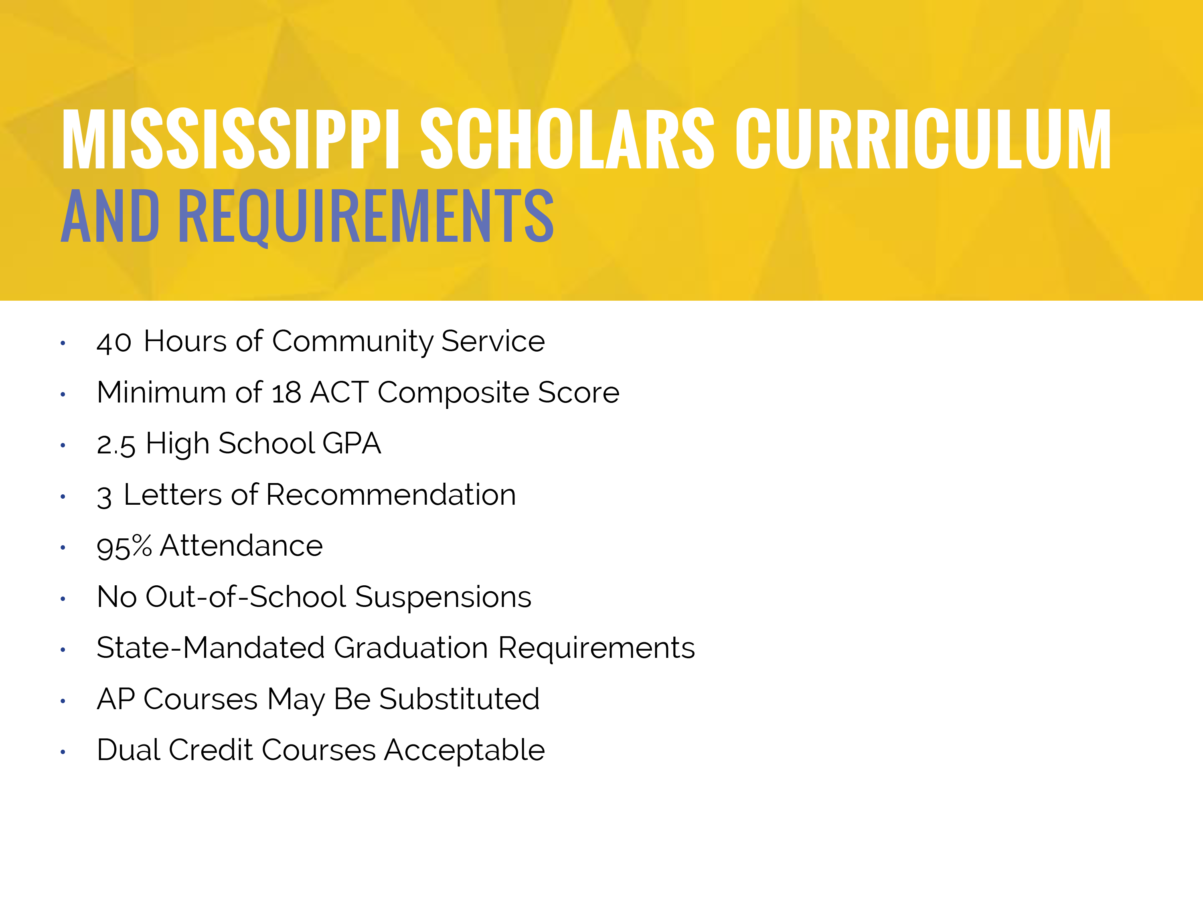
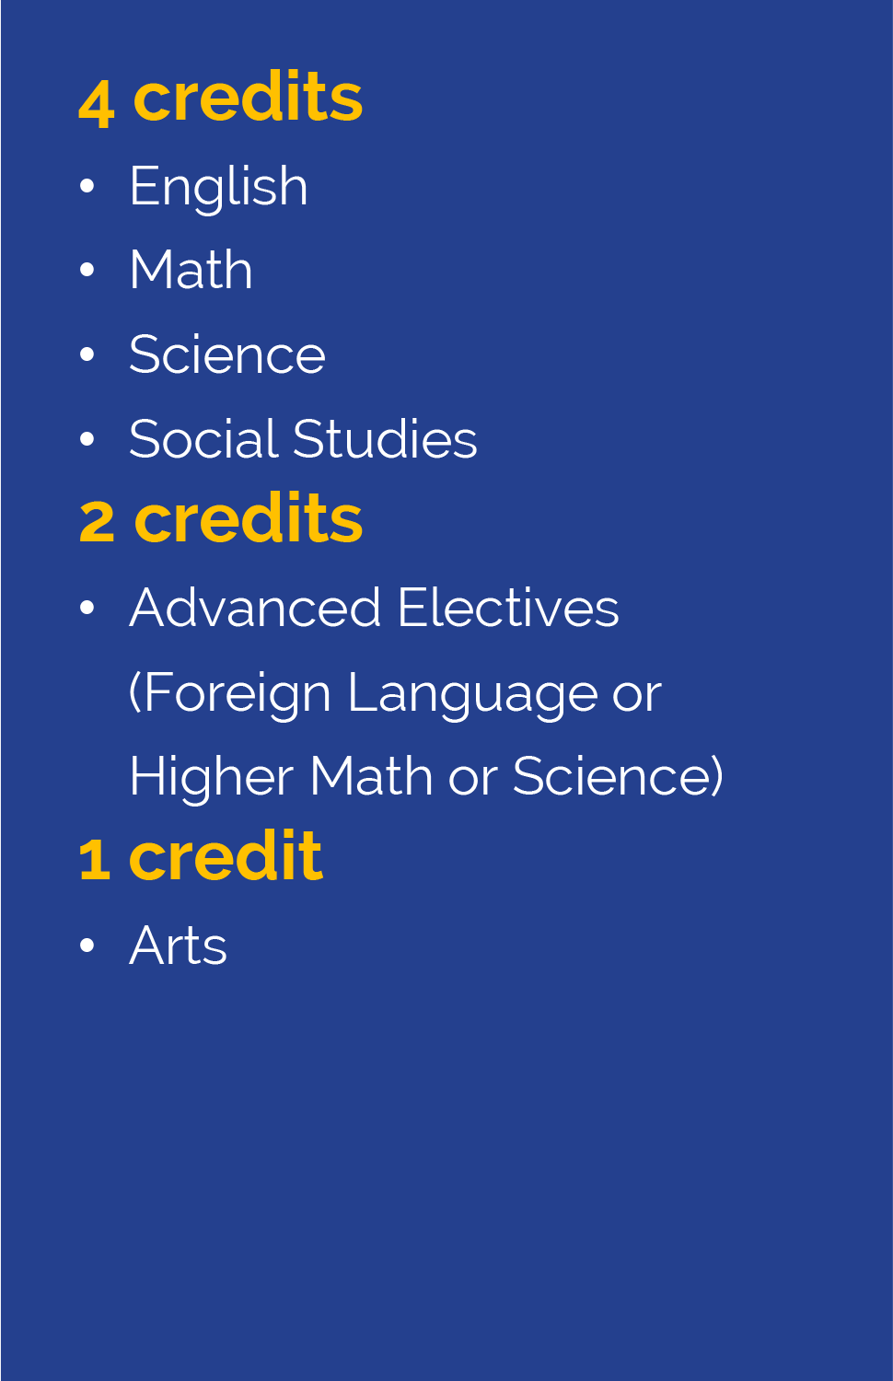

Slide 6

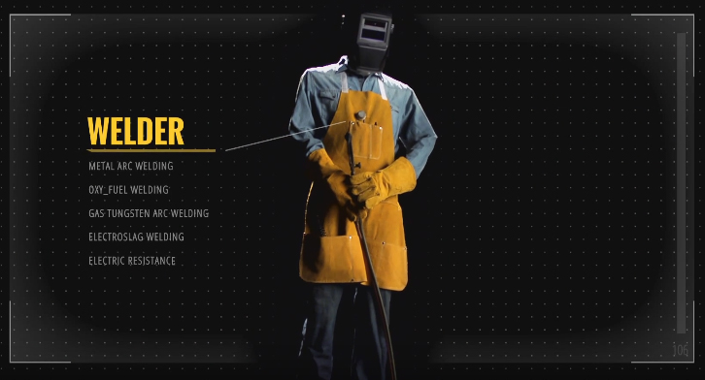

Slide 7
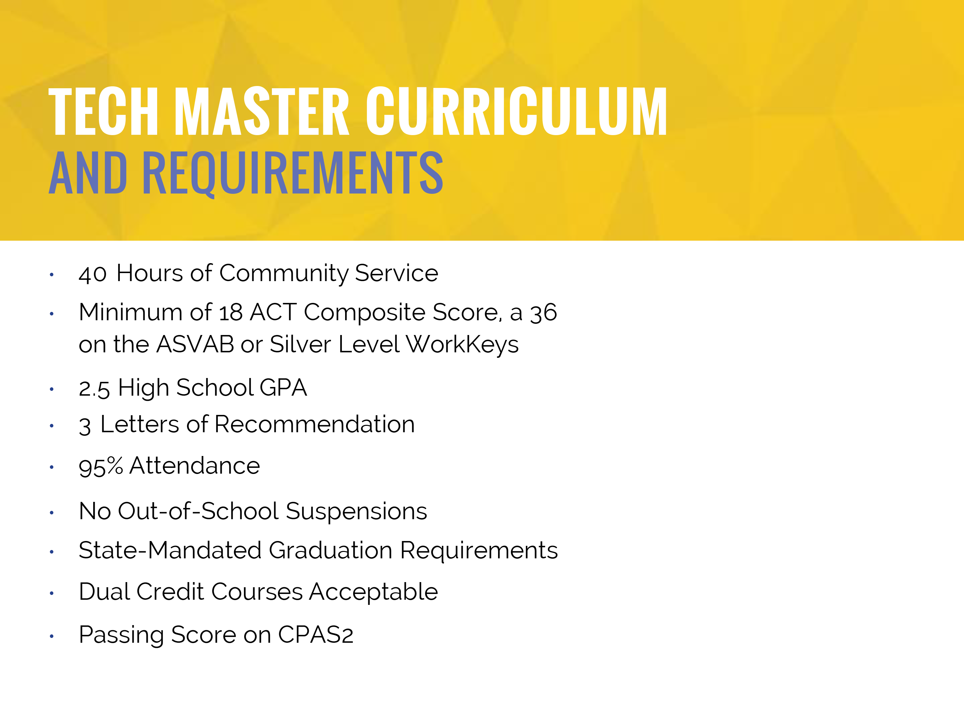
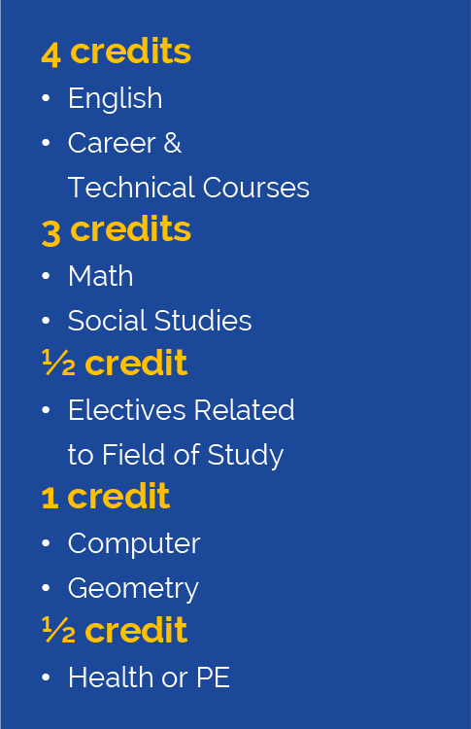

Slide 8


Slide 9

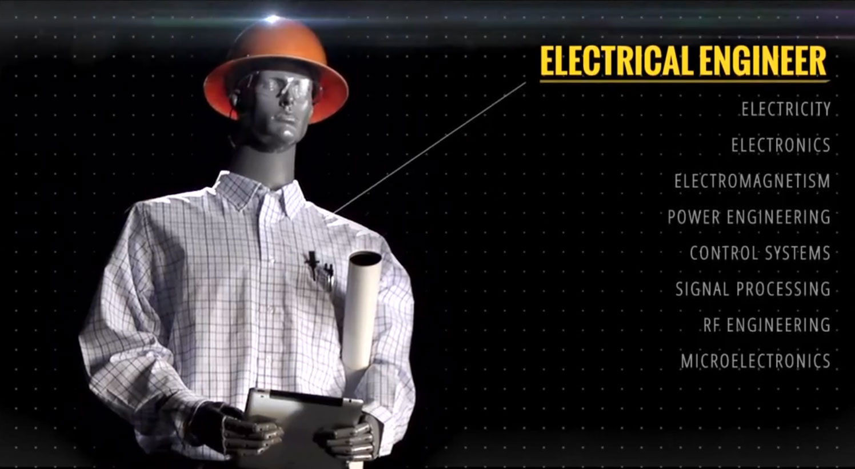
Notes:
The purpose of Get On The Grid is to connect Mississippi’s newest generation of workers with every opportunity to succeed — for their futures and the betterment of their communities.

Slide 10








DOCTOR
NURSE
SCIENTIST
LAWYER
ENGINEER
TEACHER
ARCHITECT
ACCOUNTANT
Notes:
As high school students, your whole life is ahead of you. It’s important to plan for your future now and learn the skills that will help you adapt in the ever-changing economy — no matter your chosen career field.
Ask students what their dream job is and what they think they would earn. Refer to the salaries below to let the students know if their estimate was close or not.
*Be sure to say “around” or “up to."
Management – $75,000
Business and Financial Operations – $50,000
Computer and Mathematical Science – $54,000
Architecture and Engineering – $60,000
Life, Physical and Social Science – $54,000
Community and Social Services – $35,000
Legal Occupations – $64,000
Education, Training and Library – $38,000
Arts, Design and Media – $39,000
Healthcare Practitioner and Technical – $58,000
If a student says they want to be an athlete, respond by saying:
Just the average salary for professional athletes is incredibly high, and that’s a perfectly fine career goal. But what if you get hurt and can’t play? What will you fall back on?
The answer is: your education.

Slide 11

MACHINIST
HEALTHCARE
ASSISTANT
SYSTEM
OPERATOR
ELECTRONICS
TECHNICIAN
CIVIL
ENGINEER
UTILITY
LINEMAN
WELDER
Notes:
Read entire slide, expand where needed.

Slide 12

CRITICAL PERIOD
WORKING YEARS
14 18 22
75

Slide 13

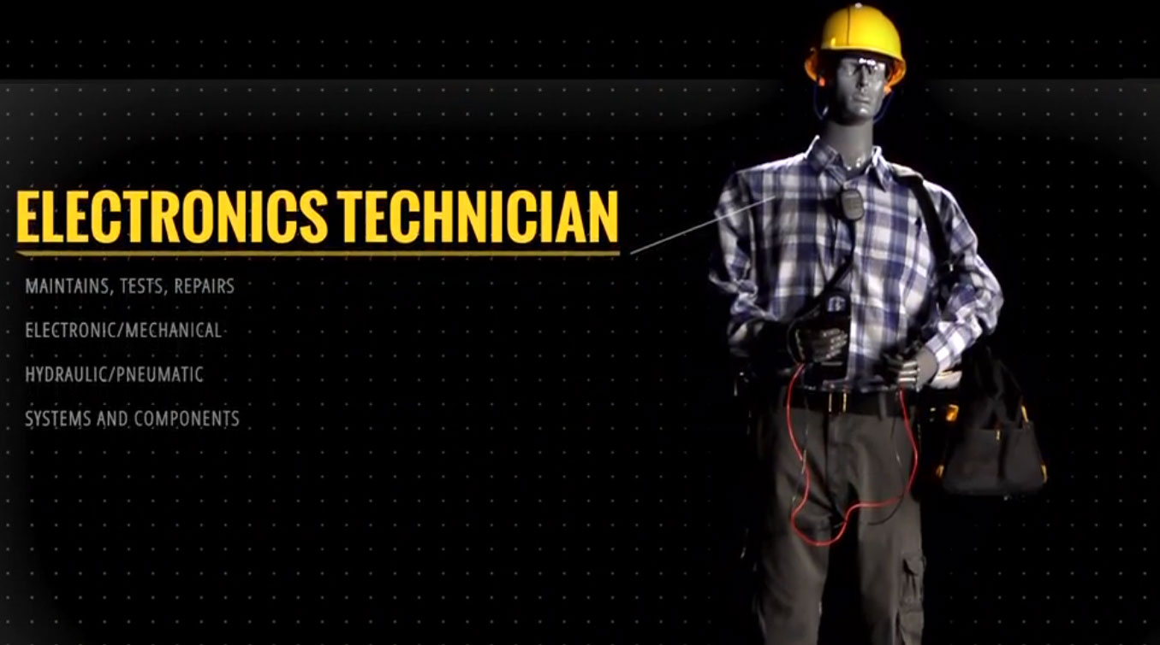

Slide 14



Notes:
Give students time to answer.

Slide 15
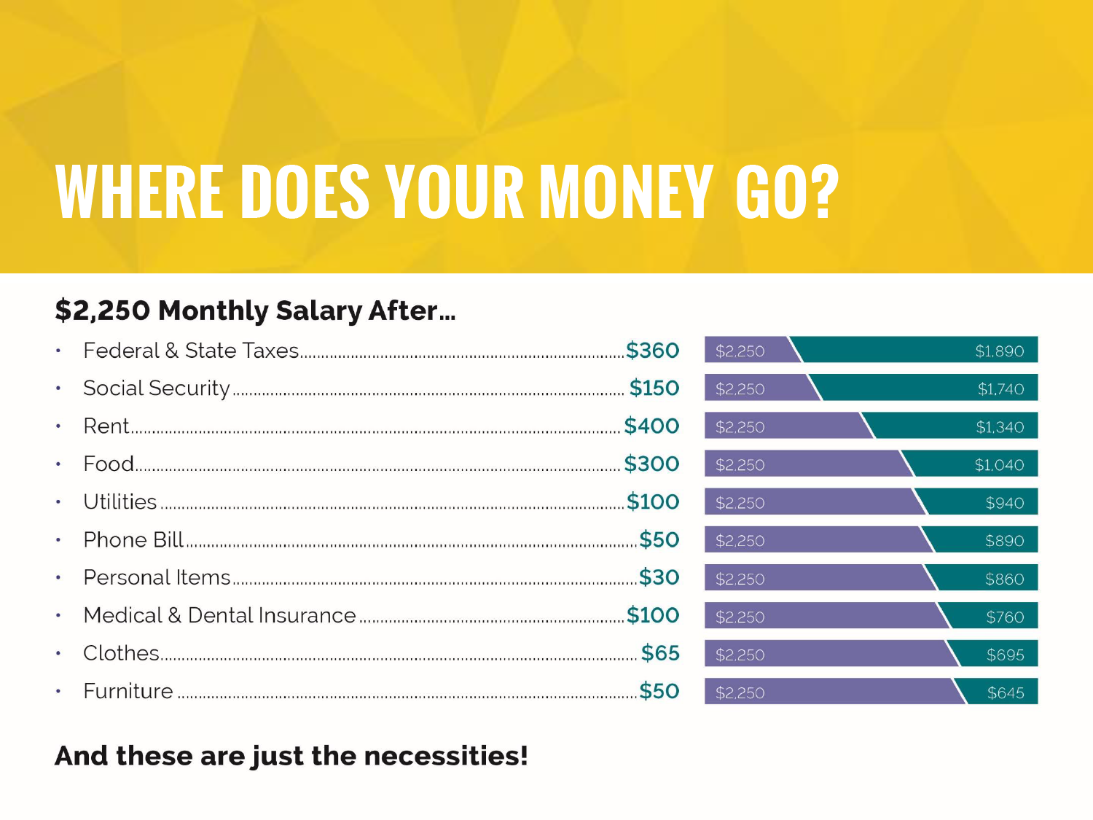
Notes:
Keep in mind that this job has a higher salary than most students will have right out of high school. Also, these estimates are pretty conservative, and spending habits vary.
So you have $645 left. Do you think that will get you through the rest of the month?
Give students time to answer.

Slide 16

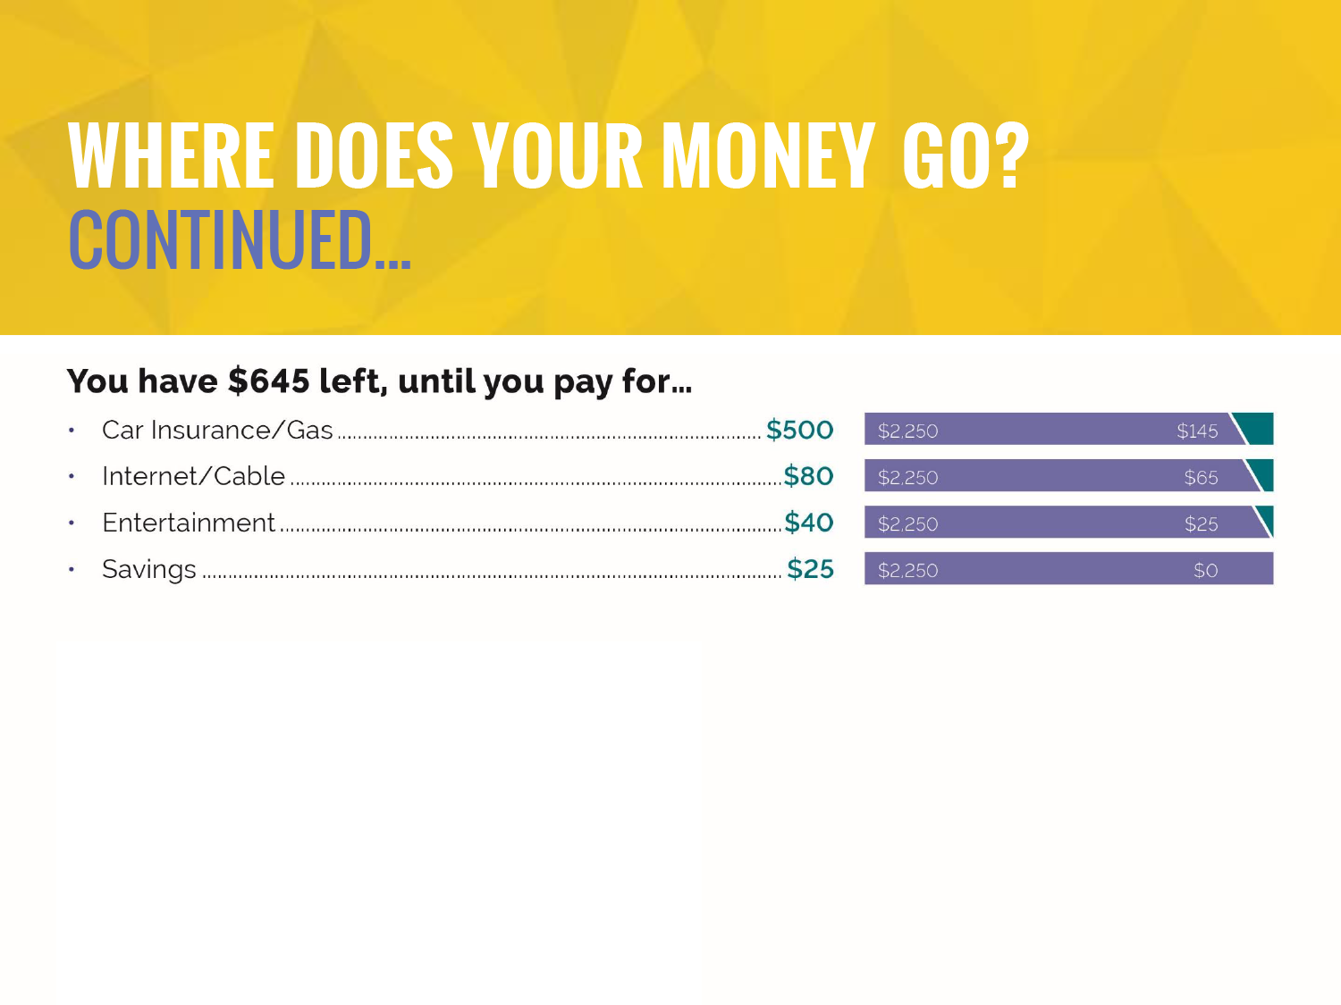


Notes:
These items are what you’d call luxury: things we all have but don’t necessarily need.
Always set aside an amount of your monthly paycheck for savings, even if it’s small at first. Although you managed to save some this month, there’s still nothing covering you until your next paycheck.
This is where your education can play a major role.

Slide 17
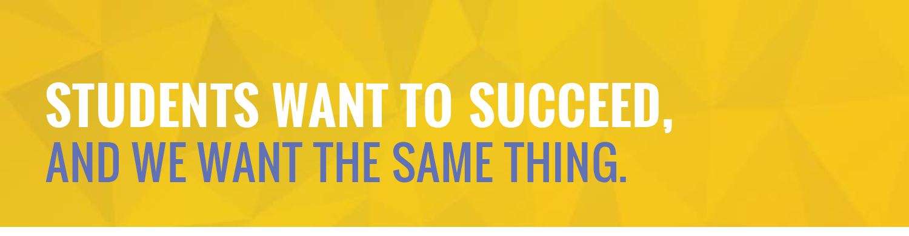











Slide 18







Slide 19



ATTENDANCE AND
SELF-PRESENTATION
COMMUNICATION
WORK ETHIC
COMPUTER
LITERACY
CAREER
DEVELOPMENT
POSITIVE
ATTITUDE
PROBLEM
SOLVING
ACADEMICS
TECHNICAL
SKILLS
UNDERSTANDING
THE BIG PICTURE
INDEPENDENCE
AND INITIATIVE
Notes:
Academics – What you’ve learned and how you can apply it.
Computer Literacy – Keeping up with technology makes you a valuable employee.
Communication – Being able to make your point just as well as hearing others.
Problem Solving – The ability to overcome obstacles, no matter how big or small.
Understanding the Big Picture – Knowing what you’re doing, and why.
Positive Attitude – It really does make all the difference.
Work Ethic – Not just working hard, but working well and taking pride in what you do.
Attendance – If you showed up in high school, you’ll show up at work.
Self-Presentation – You know what you’re doing, but you need to look like it, too.
Career Development – Look for ways to improve your role and grow professionally.
Technical Skills – No matter what you do, you’ll need to be good at it.

Slide 20





Notes:
You all have potential, and we want to foster that potential. Because you are the future of our great state, and when you succeed, so does Mississippi.

Slide 21

Notes:
Some of you may already know what you want to do after high school, whether it’s to start a two- or four-year degree program, join the military or get straight to work.
Those of you who don’t, have no fear! Mississippi Scholars and Mississippi Scholars Tech Master will help you decide where your future lies — as well as help you succeed.

Slide 22



Slide 23


Visit with your guidance counselor.
Notes:
Teachers, Get On The Grid lesson plans can be found on the Get On The Grid website, and more information on Mississippi Scholars and Mississippi Scholars Tech Master can be found on the Mississippi Economic Council website.

